Slide 1


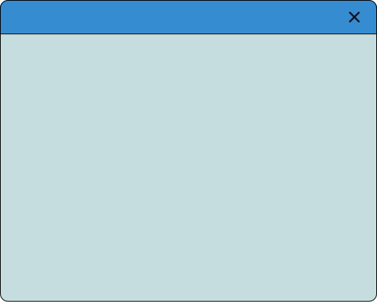


LockMess
Software
Architecture
An overview of the design architecture, analysis, and evolution of large systems by making informed decisions that balance functional requirements, quality, and organizational/human realities.
PHENIKAA SCHOOL OF COMPUTING

Slide 2

LockMess
TOPIC
DEVELOPING MOBILE MESSAGING APPLICATION
Group 04
page 01
PHENIKAA SCHOOL OF COMPUTING

Slide 3



LockMess
Introduce
Course Class | Software Architecture-1-2-25 (N01) | Software Architecture-1-2-25 (N01)
Instructor | M.Cs. Vũ Quang Dũng | M.Cs. Vũ Quang Dũng
Group | 04 | 04
Group members | Đỗ Trịnh Lệ Quyên | 23010485
Group members | Vũ Viết Huy | 23010699
Group members | Nguyễn Mạnh Cường | 23010064
page 02
PHENIKAA SCHOOL OF COMPUTING

Slide 4
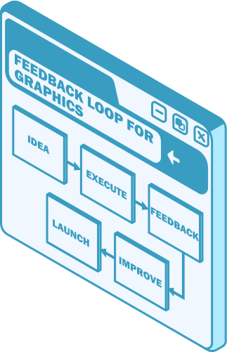
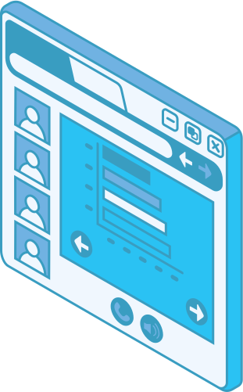

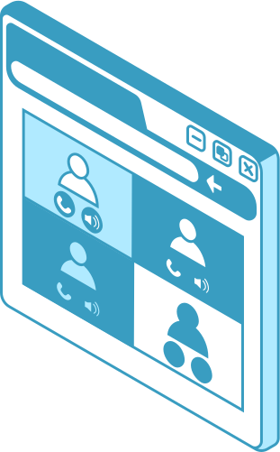

LockMess
Program Overview
Introduction to the project
Executive Summary
Project Requirements & Goals
Architectural Design & Implementation
Testing & Verification
Conclusion & Reflection
page 03
PHENIKAA SCHOOL OF COMPUTING

Slide 5

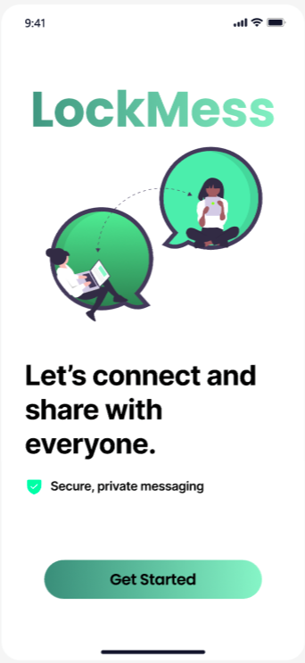
LockMess
Introduction to the project
The Industry 4.0 era has fundamentally changed the way people communicate. Traditional communication methods such as SMS or regular phone calls are gradually being replaced by internet-based messaging applications like Telegram, Messenger, Zalo, etc.
→ Modern communication needs are no longer limited to sending text messages but also require real-time responses.
To meet that need, our team decided to build a messaging application called Lockmess.
Key Differentiator: Instead of only connecting users who already know each other, the application leverages a recommendation system to suggest channels and groups based on users’ interests and personal profiles.
Core Technologies: Flutter (Mobile), Supabase (Backend-as-a-Service), and WebSockets (real-time communication).
page 04
PHENIKAA SCHOOL OF COMPUTING

Slide 6

LockMess
Executive Summary
Project Objective
The objective of this project was to design and implement a lightweight, multi-user real-time chat application.
The system aims to support simultaneous user interactions while maintaining simplicity in design and deployment.
This type of application represents a common use case in modern chat, messaging, and online collaboration systems.
Selected Architectural Approach
The project adopts a Monolithic Architecture.
This architectural approach reduces structural complexity and simplifies development and deployment, making it suitable for small to medium-scale real-time systems.
page 05
PHENIKAA SCHOOL OF COMPUTING

Slide 7
LockMess
Executive Summary
Technology and Implementation
The system is implemented using WebSocket as the primary communication mechanism between clients and the server.
WebSocket provides persistent, bi-directional communication, allowing both clients and the server to exchange messages continuously without the overhead of repeated HTTP requests.
This technology is essential for enabling real-time interaction.
page 06
PHENIKAA SCHOOL OF COMPUTING

Slide 8


Project Requirement & Goals
LockMess
Functional Requirements
The system consists of 12 core functional requirements, including but not limited to
Authentication | User registration and login via Google account (FR-01).
Messaging | Real-time text messaging (FR-03), group chat functionality (FR-04), and multimedia file sharing (FR-05).
Community | Friend search, contact list management, and discovery and participation in public channels (FR-02, FR-08, FR-09, FR-10).
Intelligent Recommendations | Automatic recommendation of suitable channels based on users’ interest tags (FR-11, FR-12).
page 07
PHENIKAA SCHOOL OF COMPUTING

Slide 9
Project Requirement & Goals
LockMess
Core Functional Requirements
ID | Description
FR-01 | The application must allow users to connect to the chat server using a unique username.
FR-02 | The application must allow a connected user to send text messages to the server.
FR-03 | The server must broadcast received messages to all other connected users in real time.
FR-04 | The application must display messages in chronological order, including the sender’s username.
page 08
PHENIKAA SCHOOL OF COMPUTING

Slide 10
Project Requirement & Goals
LockMess
Key Quality Attributes (Architectural Goals – Non-Functional Requirements)
Real-Time Response | This is the most critical quality attribute. Messages must be delivered and displayed on all connected clients with minimal perceived latency, targeting sub-200ms response times
Availability | The server should maintain persistent client connections, minimizing downtime and reducing the likelihood of dropped or interrupted communication sessions.
Modifiability | The architecture should support future extensions, such as private messaging or multiple chat rooms, without requiring major changes to the core message-handling and broadcasting logic.
Reliability | A centralized monolithic architecture simplifies connection management and improves overall system reliability.
page 09
PHENIKAA SCHOOL OF COMPUTING

Slide 11
Project Requirement & Goals
LockMess
Attribute Sensitivity Requirement (ASR) Scenario
Quality Attribute | Requirement Statement
Performance | The system must maintain persistent WebSocket connections for 10,000 concurrent users with message latency under 200ms.
Availability | If a server instance fails, client connections must automatically failover to a healthy instance without any message loss.
Modifiability | Integrating new features such as “Sticker Packs” must not disrupt or require downtime for the core “Text Chat” functionality.
page 10
PHENIKAA SCHOOL OF COMPUTING

Slide 12
Project Requirement & Goals
LockMess
Use Case Modeling
Use case | Flow Description | Actor
Join Chat | User opens the application. User enters a unique username. User establishes a WebSocket connection with the server. | User
Send Message | User types a message. User presses Send. Client sends the message and username via the persistent WebSocket. | User
Receive Message | Server receives a message from User A Server broadcasts the message to all User A’s socket. Client displays the new messageinstantly. | All user
page 11
PHENIKAA SCHOOL OF COMPUTING

Slide 13
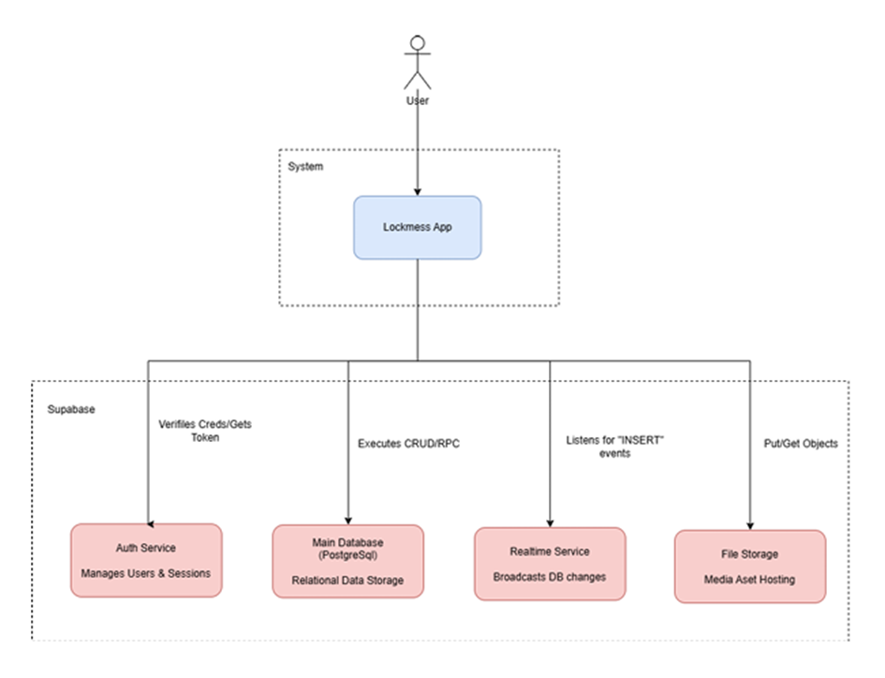
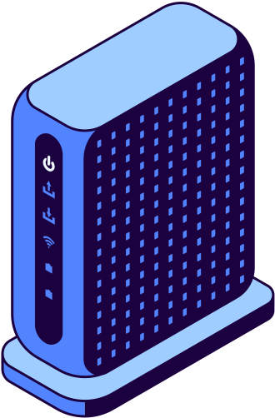
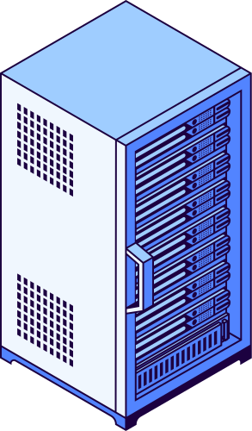
LockMess
Architectural Design & Implementation
C1 & C2: High-Level System Context And Container
Scope: Visualizes the boundaries of the Lockmess messaging system and its external actors.
User Interaction: Users interact with the mobile application to join communities, manage profiles, and communicate in real-time.
External System: The system relies on the Supabase Platform as the core infrastructure provider for backend services.
Purpose: Defines high-level data flow and establishes how the system serves its users through external dependencies.
page 12
PHENIKAA SCHOOL OF COMPUTING

Slide 14
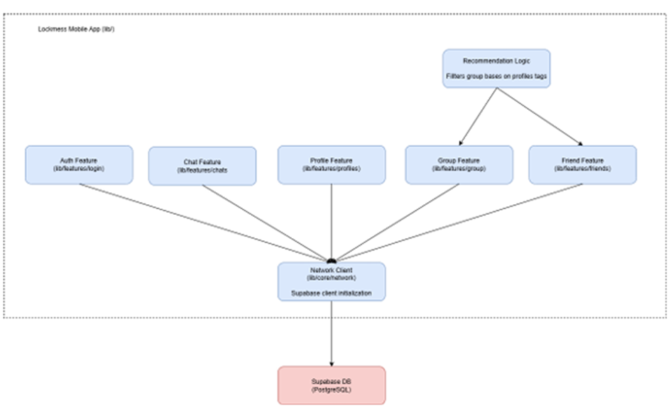
LockMess
Architectural Design & Implementation
C3: Modular Feature Decomposition
Feature-Based Modules: The application is structured into independent modules (Auth, Chat, Profile, Group, Friend, Recommendation) to ensure high modifiability.
Separation of Concerns: Prevents tight coupling, ensuring that updates to one feature do not inadvertently break others.
Network Client Component: A centralized shared component that initializes and manages the Supabase SDK client for all feature modules.
Data Flow: Features communicate with the Supabase DB through this unified client to maintain connection consistency.
page 13
PHENIKAA SCHOOL OF COMPUTING

Slide 15
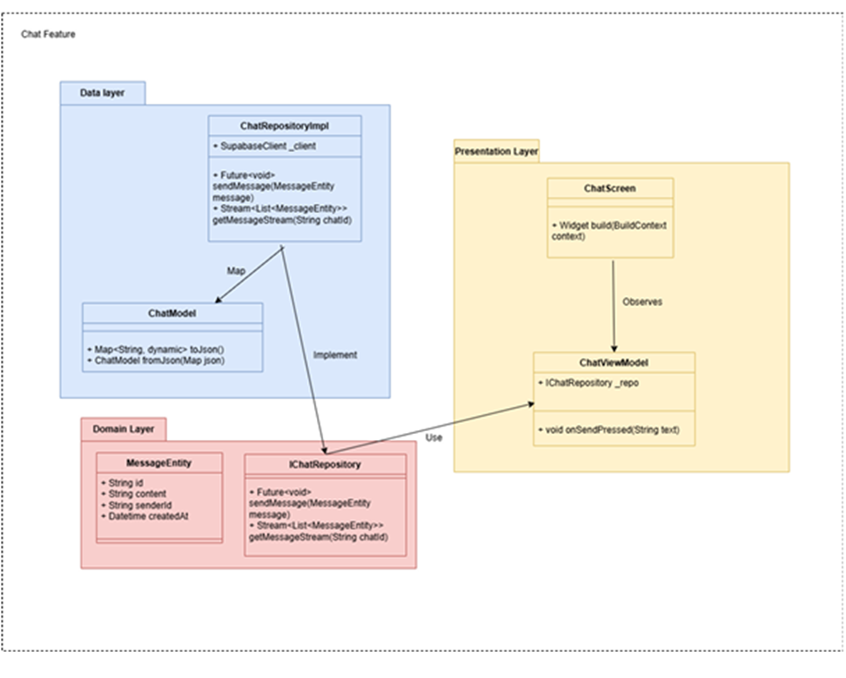
LockMess
Architectural Design & Implementation
C4: Detailed Design via Clean Architecture
Architectural Pattern: Implemented using Clean Architecture to separate technical implementation from business rules.
Presentation Layer: Contains ChatScreen for rendering and ChatViewModel for state observation and user event handling.
Domain Layer: Defines the IChatRepository interface and MessageEntity to create a technology-agnostic core.
Data Layer: ChatRepositoryImpl realizes the interface by interacting with the Supabase Client and mapping JSON via ChatModel.
page 14
PHENIKAA SCHOOL OF COMPUTING

Slide 16
LockMess
Architectural Design & Implementation
Optimized Communication Protocols
Hybrid Strategy: Selected specific protocols to balance real-time performance with data reliability for all users.
Real-time Reception: Uses WebSockets (WSS) for asynchronous message updates, satisfying the Real-time Response goal (ASR-1).
Transaction Integrity: Uses HTTPS (RPC/REST) for synchronous actions like sending messages and authentication to ensure data durability.
Efficiency: The Recommendation Engine runs locally on the device to provide instant results using cached data, reducing server load.
page 15
PHENIKAA SCHOOL OF COMPUTING

Slide 17
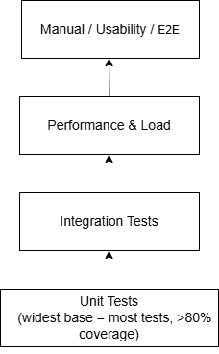

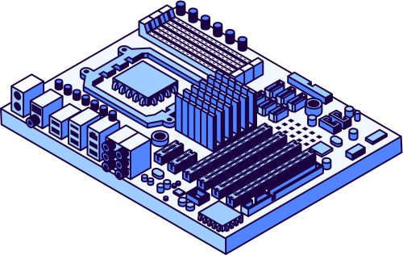
LockMess
Testing &Verification
Testing Strategy
Multi-level: Unit → Integration → Performance → Manual/Usability
Tools: Flutter test, integration_test, Supabase Dashboard, load simulation
Focus areas:
• Latency < 1 second
• Reliability (reconnection, no message loss)
• Stable concurrency & broadcast
Overall results: >80% unit coverage, >95% pass rate
page 16
PHENIKAA SCHOOL OF COMPUTING

Slide 18
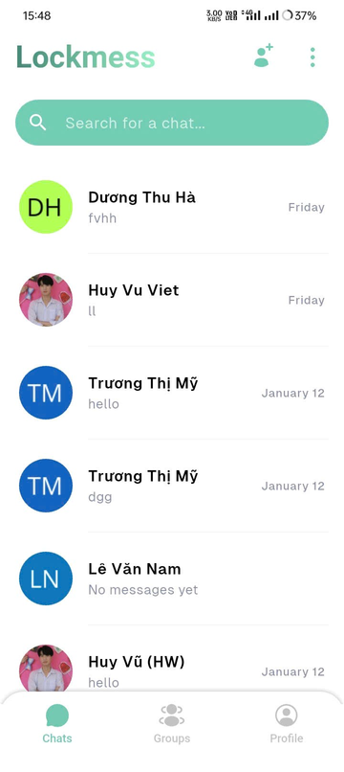
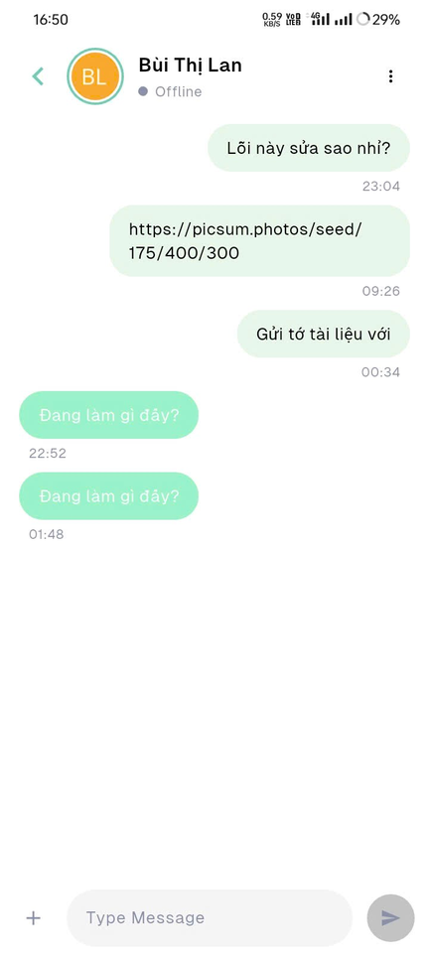
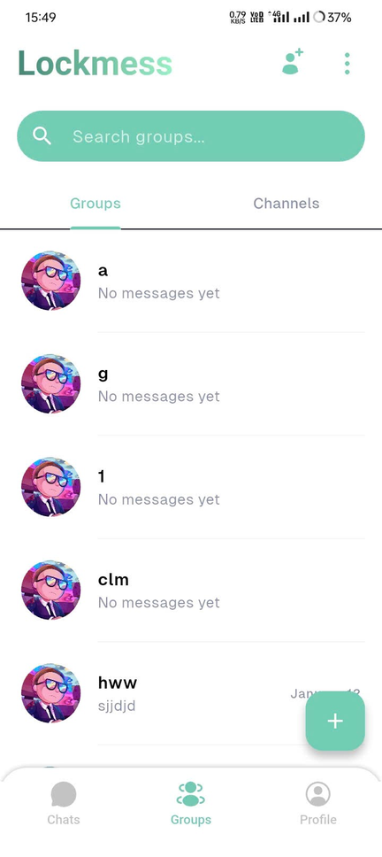
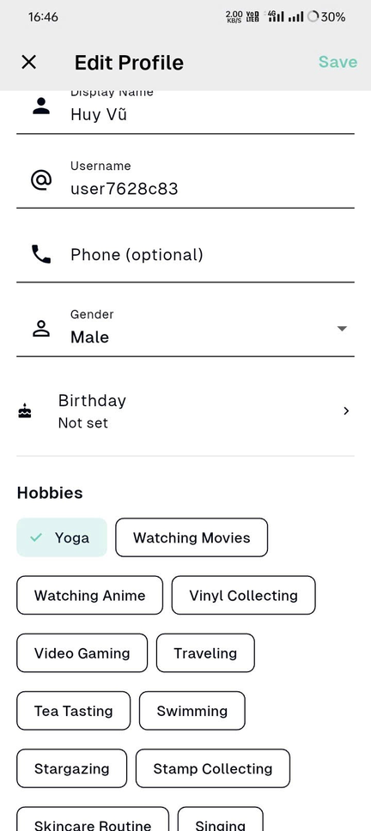
LockMess
Testing &Verification
Key Test Results
Real-time messaging: Send → receive <1s, instant broadcast via WebSocket + EDA
Group/Channel: Messages delivered simultaneously to all members
Personalization:
• Select hobbies → save → matching channels appear instantly
• Change hobbies → recommendations update in real-time
Network error handling: Auto-reconnect & message sync
Summary: Stable under concurrent load, meets latency & reliability goals
page 14
PHENIKAA SCHOOL OF COMPUTING

Slide 19


LockMess
Conclusion & Reflection
Achievements
Reflection & Lessons
Delivered fully functional Lockmess: real-time chat, groups/channels, interest-based recommendations
Architecture: Monolithic + EDA + WebSocket → low latency, high reliability
Flutter client + Supabase BaaS → simple, effective, no custom server needed
Testing confirmed: <1s latency, stable concurrency, >95% pass rate
Monolithic strengths: fast development, easy debugging, suitable for small–medium scale
Limitation: potential bottleneck at large scale → consider microservices later
Clean Architecture greatly improves maintainability & testability
Future directions:
• Add media support (images, video, voice)
• Advanced ML-based recommendations
• Message queues for high load
• Production cloud deployment & monitoring
page 09
PHENIKAA SCHOOL OF COMPUTING

Slide 20
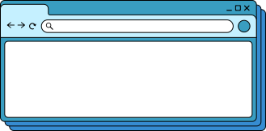

Wardiere.Inc
Thank You!
Thank you for your attention. We hope this presentation will enhance your understanding of the project's software architecture
page 015
www.reallygreatsite.com

